Slide 1
SWE30003
Software Architectures and Design
Lecture 9 (from 2024, move Tactics here from W11)
Architecture Design: Case Study, and Tactics
Notes:
SWE30003 Software Architectures and Design
S1 2023
© Swinburne University of Technology

Slide 2
Logistical matters
Weekly submissions – A & Q
  Week 2: 104 & 101 out of 119;
  Week 3: 101 & 98 out of 118;
  Week 4: 102 & 101 out of 118;
  Week 5: 98 & 98 out of 118;
  Week 6: 88 & 84 out of 117;
  Week 7: 108 & 104 out of 117;
  Week 8: 91 & 93 out of 117;
  Week 9: 103 & 98 out of 117
  No late submission, hurdle requirement
Assignment 3: to be released Monday morning. … start asap!
Notes:
SWE30003 Software Architectures and Design
S1 2023
© Swinburne University of Technology

Slide 3
Question to Answer – Week 8
Would a messenger application be considered as peer to peer or client/server architecture considering communication is generally direct to the other peer once the IP address of a remote user has been identified by the server? Justify your answer.
Notes:
SWE30003 Software Architectures and Design
S1 2023
© Swinburne University of Technology

Slide 4
Principal References – this week
Len Bass, Paul Clements, and Rick Kazman, Software Architecture in Practice (4th Edition), Addison-Wesley, 2021, Chapters 3 – 14. OR
Len Bass, Paul Clements, and Rick Kazman, Software Architecture in Practice (3rd Edition), Addison-Wesley, 2013, Chapters 4 – 13.
Notes:
SWE30003 Software Architectures and Design
S1 2023
© Swinburne University of Technology

Slide 5
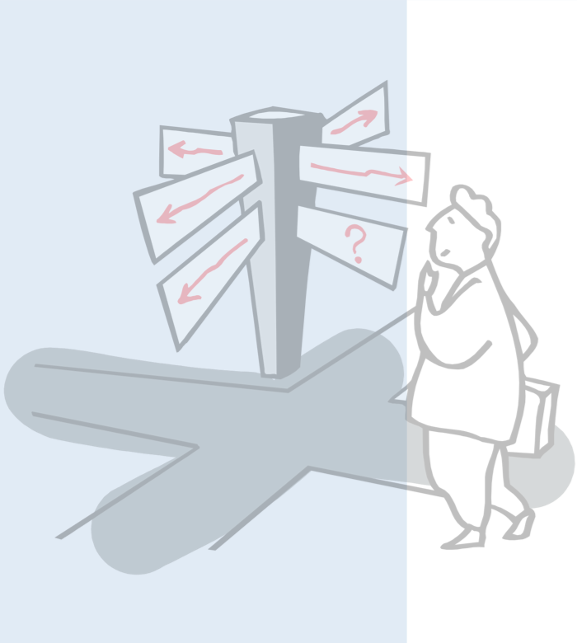
Outline
Case Study in Architecture Design
Architectural Tactics
Notes:
SWE30003 Software Architectures and Design
S1 2023
© Swinburne University of Technology

Slide 6
A Case Study in Architecture Design
(small problem, big architectural implications)

Slide 7
Keywords in Context
“The Key Word in Context (KWIC) index system accepts an ordered set of lines, each line is an ordered set of words, and each word is an ordered set of characters. Any line may be “circularly shifted” by repeatedly removing the first word and appending it at the end of the line. The KWIC index system outputs a listing of all circular shifts of all lines in alphabetical order [ignoring case].”
David Parnas, On the Criteria to be Used in Decomposing Systems into Modules, 1972

Slide 8
Keywords in Context (cont.)
Input:
Software Architectures and Design
Keyword in Context
Output:
and Design Software Architectures
Architectures and Design Software
Context Keyword in
Design Software Architectures and
in Context Keyword
Keyword in Context
Software Architectures and Design
Notes:
One may need to explain in more detail how this is to work…
SWE30003 Software Architectures and Design
S1 2023
© Swinburne University of Technology

Slide 9

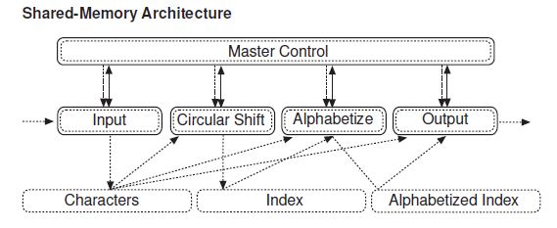

Slide 10
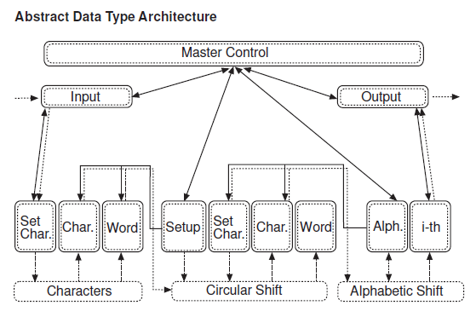

Slide 11
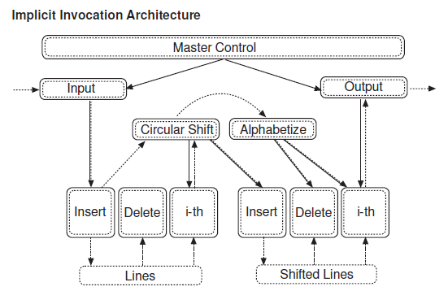

Slide 12
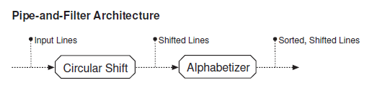

Slide 13
Keyword in Context - Forces
Changes in processing scheme
  Eager vs. lazy processing
Changes in (internal) data representation
  Important if large input data sets need to be processed!
Enhancements to functionality
  Omit “noise words” (e.g., ‘a’, ‘an’, ‘the’) in a circular shift
Performance
  Time complexity vs. space complexity
Reuse
Identify a solution and analyze it using the above criteria.

Slide 14
Architecture & quality
KWIC – Shared Memory
  + performance
  - modifiability
KWIC – ADT
  + modifiability
  - performance (speed and space)

Slide 15
Architecture & quality (ctd)
KWIC – Implicit Invocation
  + extentensibility
  - control (order …)
  - space
KWIC – PnF
  + intuitive/understanding
  + reuse
  - - performance (speed and space)

Slide 16
Break

Slide 17
Outline
Case Study in Architecture Design
Architectural Tactics
Notes:
SWE30003 Software Architectures and Design
S1 2023
© Swinburne University of Technology

Slide 18
Outline
Architectural Tactics
Design Documentation
  Purpose of Documentation
  Views
  Notations
Design Evaluation
Notes:
SWE30003 Software Architectures and Design
S1 2023
© Swinburne University of Technology

Slide 19
Architectural Tactics
An architectural tactic is a transformation on an architecture or a change to the input to a system that results in the improvement of a specific quality attribute(s).
Examples:
  Information hiding is a transformation on an architecture that improves modifiability
  Redundancy is a transformation on an architecture that improves availability, reliability, and/or performance.
  Reducing the arrival rate of requests is a change to the input of a system that improves latency.
Notes:
SWE30003 Software Architectures and Design
S1 2023
© Swinburne University of Technology

Slide 20
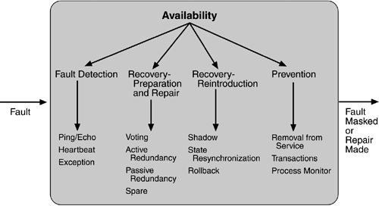
Tactics - Availability
Notes:
SWE30003 Software Architectures and Design
S1 2023
© Swinburne University of Technology
These tactics need to be explained in some more detail!
Note that they are from the second edition of the book – the third edition adds a few more…

Slide 21
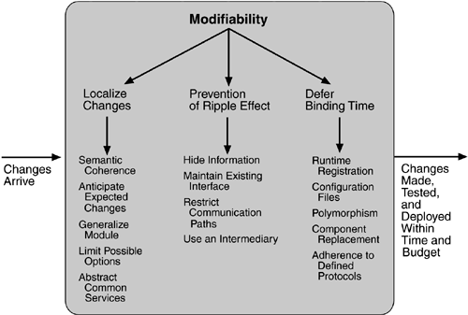
Tactics - Modifiability
Notes:
SWE30003 Software Architectures and Design
S1 2023
© Swinburne University of Technology
These tactics need to be explained in some more detail!

Slide 22
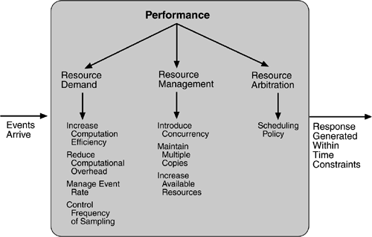
Tactics - Performance
Notes:
SWE30003 Software Architectures and Design
S1 2023
© Swinburne University of Technology
These tactics need to be explained in some more detail!

Slide 23
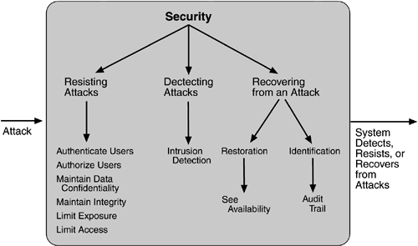
Tactics - Security
Notes:
SWE30003 Software Architectures and Design
S1 2023
© Swinburne University of Technology
These tactics need to be explained in some more detail!

Slide 24
Patterns vs. Tactics
“Any pattern implements several tactics, often concerned with different quality attributes, and any implementation of the pattern also makes choices about tactics.”
— Len Bass et al., Software Architecture in Practice, 2013
Notes:
SWE30003 Software Architectures and Design
S1 2023
© Swinburne University of Technology

Slide 25
Tactics in Patterns/Styles
What Architectural Tactics are used/applied in the following Patterns/Architectural Styles:
  Template Method
  Composite
  Observer / MVC
  Layers
Notes:
SWE30003 Software Architectures and Design
S1 2023
© Swinburne University of Technology
Discuss the mentioned Patterns/Architectural Styles from an Architectural Tactics perspective…

Slide 26
Further Information
A number of articles on Canvas (under week 9) provide more details, including
Pre-readings
Parnas article
Garlan article
Notes:
SWE30003 Software Architectures and Design
S1 2023
© Swinburne University of Technology

Slide 27
Questions for consideration
What is the purpose of the Shared-Memory Architecture and the Abstract Data Type Architecture, and how do they differ from one another when it come to the solutions they are utilized for?
To what degree does available hardware constrain the choice of architectural style? Are there any architectural styles that are impossible or highly impractical to implement without a certain hardware configuration?
What is the Independent Component Architecture? Why would you use the Independent Component Architecture over another architecture?
What architectural style should we use to design a remote system to control multiple robot hands in car assemble process in car factory?
Notes:
SWE30003 Software Architectures and Design
S1 2023
© Swinburne University of Technology

Slide 28
Question to Answer – Week 9
Discuss the differences, advantages, and disadvantage of data-centred and data-flow architectures. Give examples where either of these two styles would be applicable.
Notes:
SWE30003 Software Architectures and Design
S1 2023
© Swinburne University of Technology

Slide 29
Required Reading Week 10
Service Oriented Architectures (SOAP, REST, and Micro-Services) – one or more in order as pre-reading:
Michael N. Huhns, Munindar P. Singh: Service-Oriented Computing: Key Concepts and Principles. IEEE Internet Comput.9(1): 75-81 (2005) (Link to an external site)
Stefan Tilkov: A Brief Introduction to REST. InfoQ (2007) (Link to an external site)
Chris Richardson: Microservices: Decomposing Applications for Deployability and Scalability. InfoQ (2014) (Link to an external site)
P Jamshidi, C Pahl, NC Mendonça, J Lewis, S Tilkov: Microservices: The journey so far and challenges ahead. IEEE Software (2018) (Link to an external site)
Notes:
SWE30003 Software Architectures and Design
S1 2023
© Swinburne University of Technology

